Slide 1

ACADEMIC PERFORMANCE EVALUATOR
A WEB APPLICATION

Slide 2
01
ABSTRACT
02
03
04
TABLE OF CONTENTS
05
MOTIVATION
LITERATURE REVIEW
MAIN FEATURES OF THE PROJECT
FACILITIES REQUIRED FOR PROPOSED PROJECT
06
MODULES
07
MAIN DATABASE TABLES
08
DATABASE TABLES RELATED TO STUDENT
09
HARDWARE/SOFTWARE REQUIREMENTS
10
SCREENS
11
BIBLIOGRAPHY
12
TEAM

Slide 3

Abstract
Students’ academic performance is evaluated by their performance in exams conducted by the institutes or Universities. This system evaluate students academic performance by considering several factors. In this method, we consider three parameters attendance, internal marks and external marks which are considered to evaluate students final academic performance.

Slide 4

Motivation
The motivation for doing this project was primarily an interest in undertaking a challenging project in an interesting area of research. The opportunity to learn about a new area of computing not covered in lectures.
We came up with the idea of this project in view of this Universal pandemic (COVID-19).

Slide 5


LITERATURE REVIEW
Wrong data entry for attendance or marks may causes problems in accuracy of academic performance.
User have to refresh page if any data has changed. And we are working to remove this problem
ADVANTAGES
This evaluation system is more accurate than conventional methods.
Student Information uploaded once should not be lost and errors can be corrected.
This system is very beneficial for education institutes or universities for academic performance evaluation of student efficiently.
DISADVANTAGES

Slide 6



MAIN FEATURES of the project
Evaluation of Academic Performance
Prediction of future performance
Displaying marks (internal and external)
Displaying attendance
Notices
Information about events and seminars
Class schedule
Holidays/Calendar
Create or upload notices/documents (provided online text editor)
Send individual’s performances on their email in just one click
Quiz/test system by which students will also be able to self-assess themselves.

Slide 7

Facilities required for proposed work
Software/Tools
Python
Django
SQLite3
Visual Studio Code
Browser(Any)
Packages
Rest_framework
Django-import-export,
Pillow
python-dotenv
Web Technologies
HTML
CSS
Javascript
Bootstrap

Slide 8

Modules
Student Module:
Student Login : Login with valid username and password.
View Academic performance : Student can view his/her academic performance based on attendance and marks.
Take assessments : Students can self assess themselves.
Admin Module:
Admin Login : login with valid username and password.
Fill Student Details : Insert proper details of attendance , marks of registered student.
Evaluate Performance : Attendance and marks details of student will be considered and give the final academic performance result.

Slide 9

Main database tables
USER
PROFILE
STUDENT
STAFF
TEACHER
HOD
DIRECTOR

Slide 10
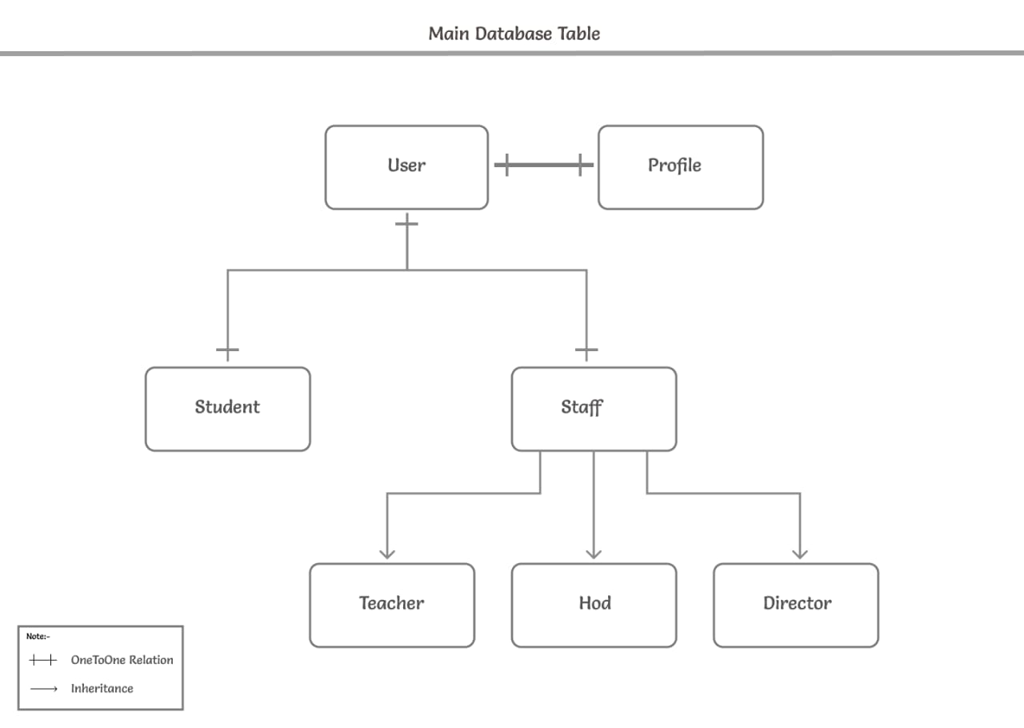
Table

Slide 11

Database tables related to student
THERE WILL BE 3 DATABASE TABLES RELATED TO STUDENT :
STUDENT ATTENDANCE
LIBRARY
MARKS

Slide 12

1. Student attendance
This database table stores every student's attendances of his department.
It has 4 fields/columns - student, semester, date and is_present.
The field/column student is connected with foreign key with student_id of the Student table / model.
The teacher can add student's attendance manually or using excel sheet, JSON its files and can export all or filtered data to excel sheet, JSON etc. formats.

Slide 13

2. library
This database table stores every student's library book details which student issued.
The field/column student is connected with foreign key with student_id of the Student table / model.
From this table/model's data the portal will notify the student about for last date of submit-reissue.
There is a possibility of duplicate attendance (same student with same date) if by any mistake teacher inserts a duplicate attendance when it will not save and warn him "Student attendance with this Student and Date already exists".

Slide 14

3. Marks
This table consists RGPV result data of every student for each semester with PDF file.
The main motive of making this feature/database table is, As we all know that there is an annual subscription fee for RGPV site from every student and sometime student forgot to pay.
At that time, student can't know their result data or can't send result data to their TG. So we have added this feature for making student and teacher's work easy.
By this feature student and teacher can view his marks and can download result's PDF file.

Slide 15

HARDWARE/SOFTWARE REQUIREMENTS
SOFTWARE REQUIREMENTS :
OS – any (Windows, Linux)
Browser – any
Internet connection
HARDWARE REQUIREMENTS :
Hard Disk – 1 GB or Above
RAM required – 4 GB or Above
Processor – Core i3 or Above

Slide 16
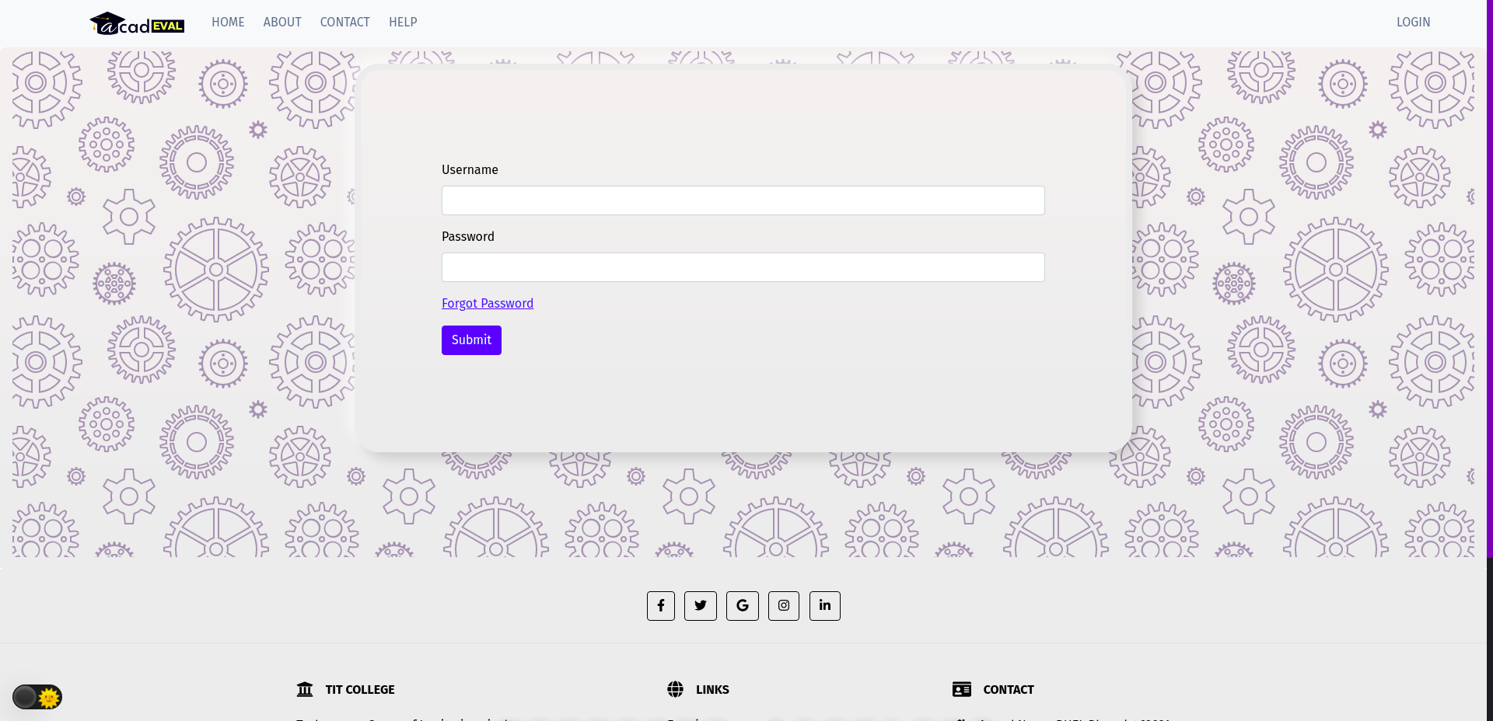
screens
Login Page

Slide 17
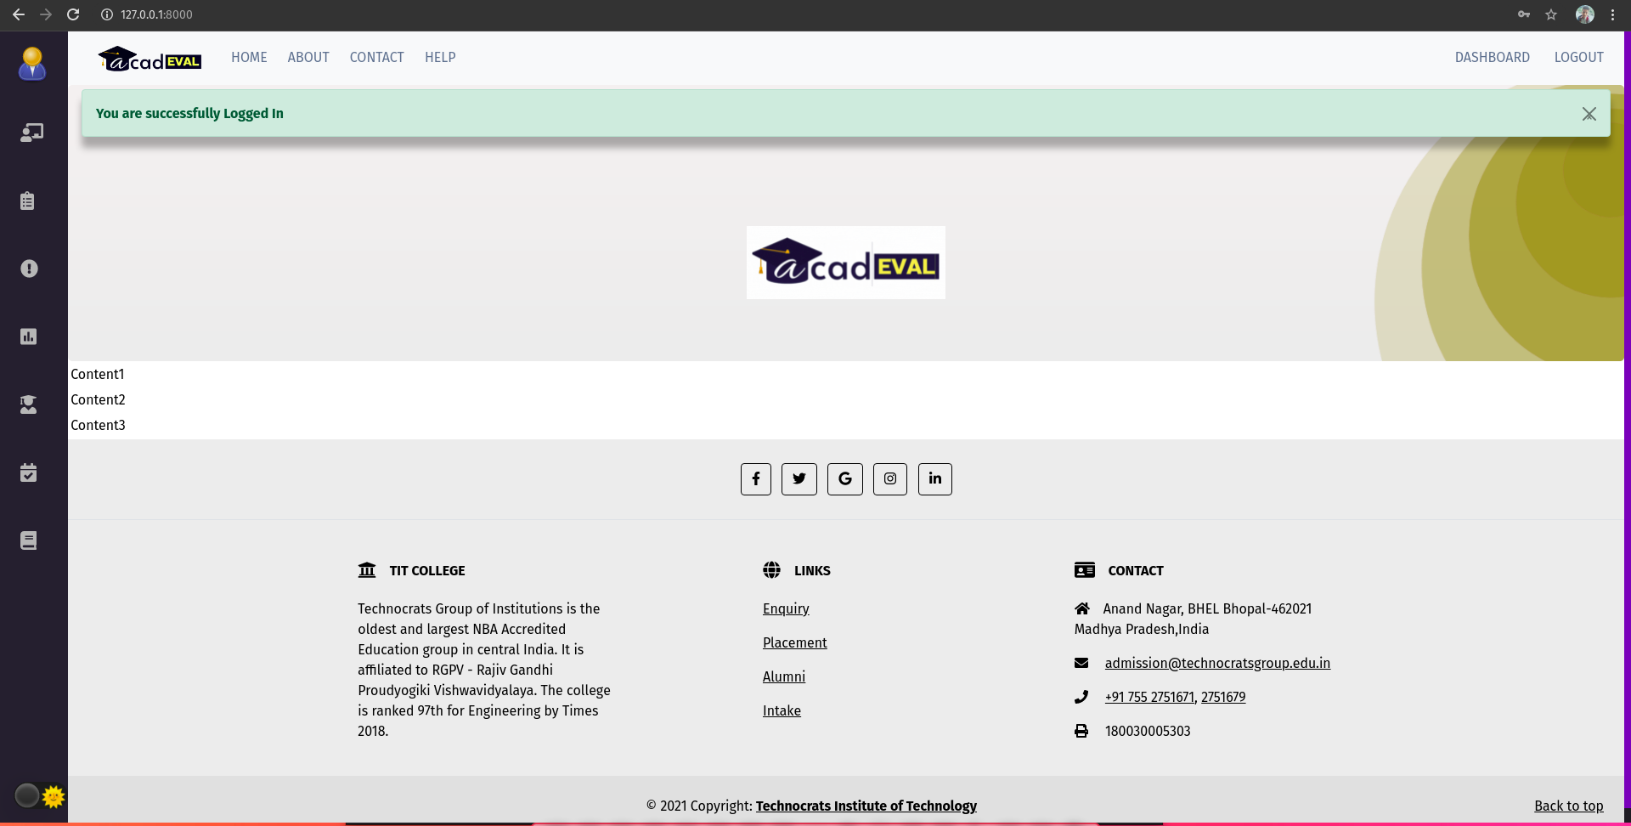
Homepage

Slide 18
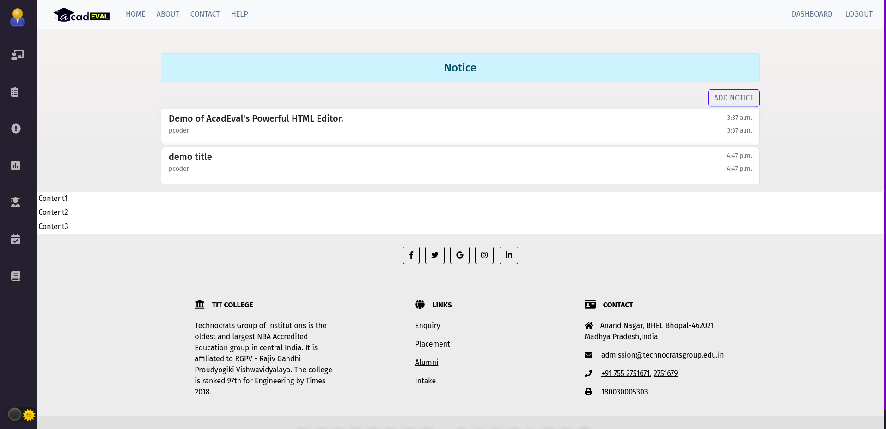
Notice Page

Slide 19
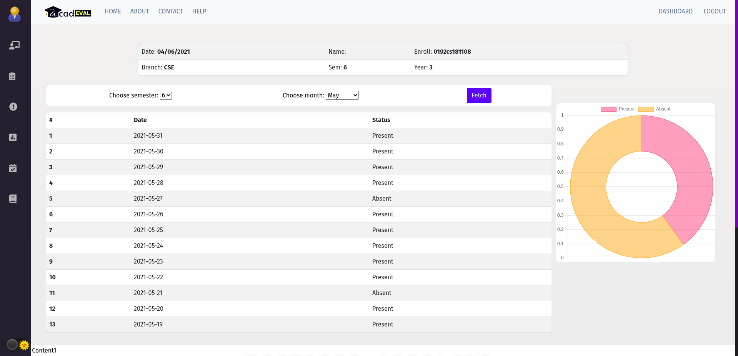
Attendance Table

Slide 20
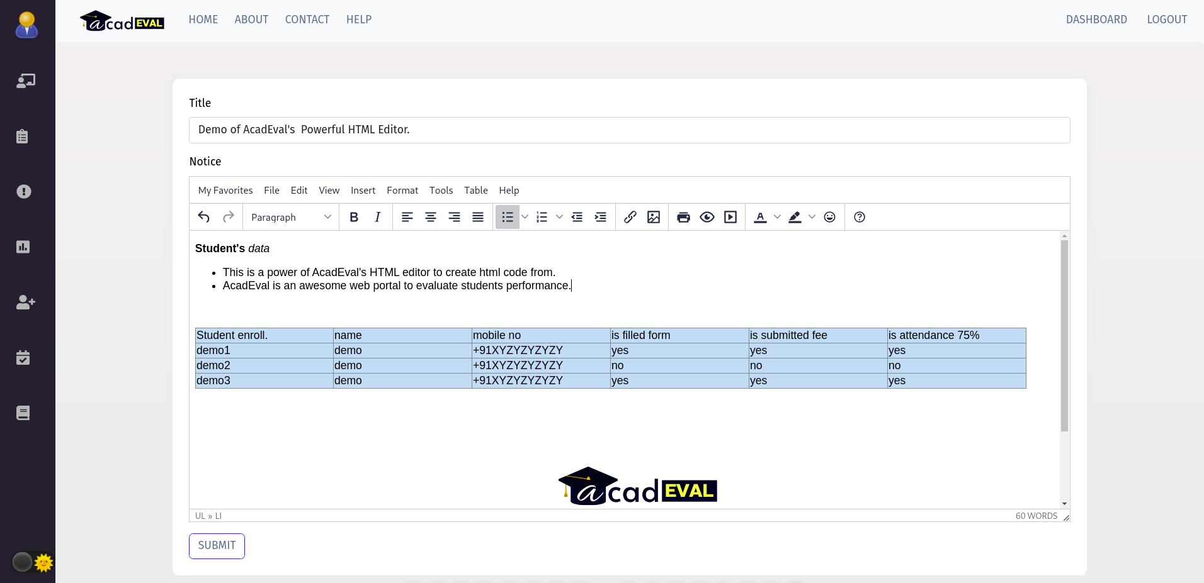
HTML editor

Slide 21
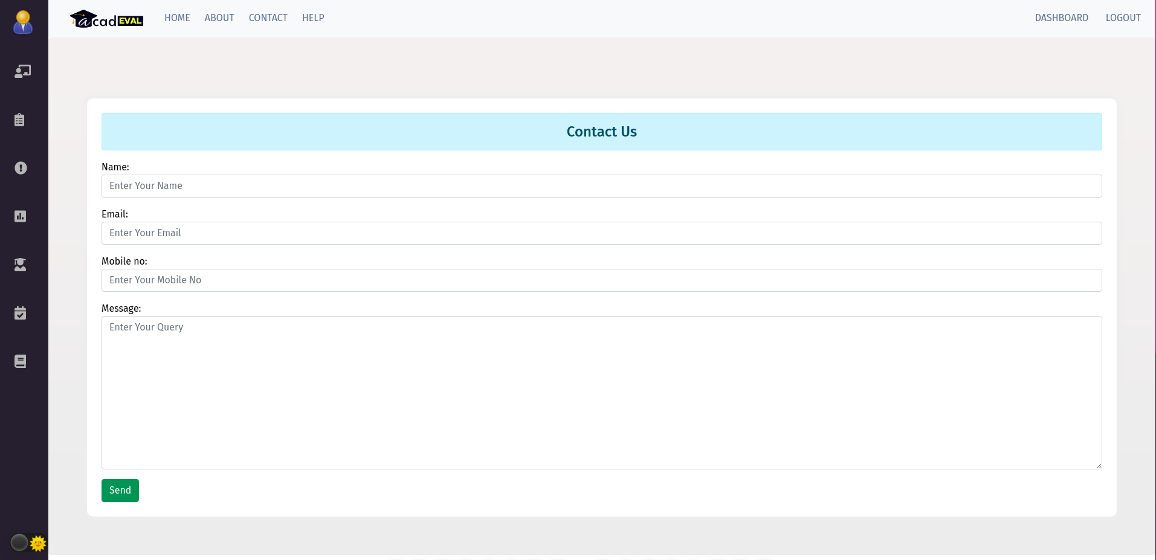
Contact us

Slide 22
Bibliography
www.google.com
Django’s official documentation : https://django.readthedocs.io/en/stable/
https://django-import-export.readthedocs.io
Django rest framework : https://www.django-rest-framework.org/
https://stackoverflow.com/
http://ieeexplore.ieee.org/document/

Slide 23


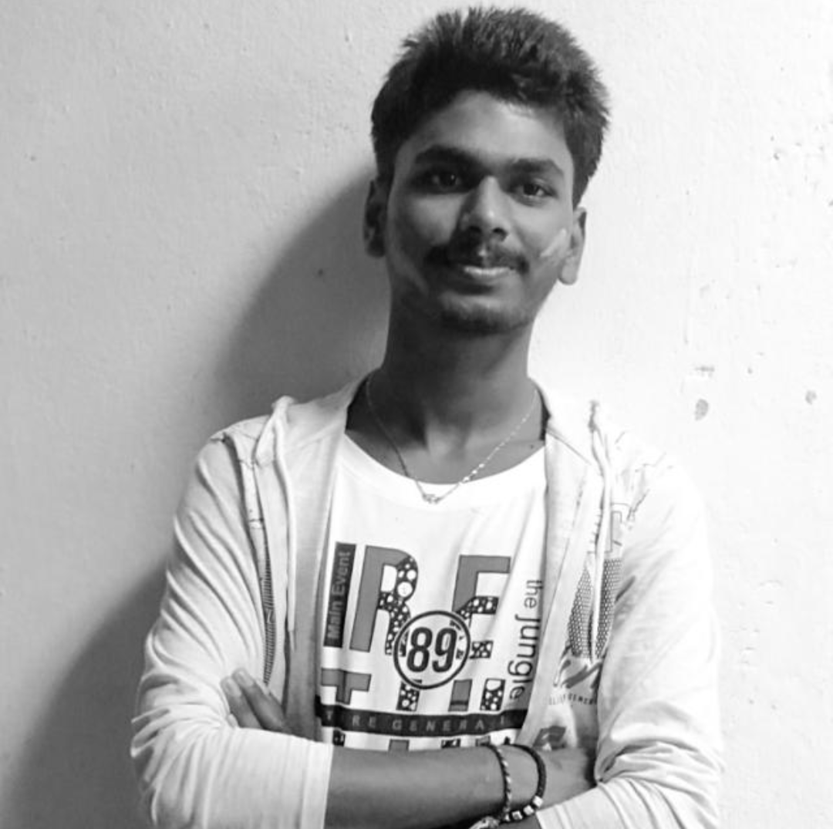

team
Praveen yadav
Siddhartha mishra
Vishal gupta
Deepak kumar singh
My name is Praveen Yadav. My highest degree is a full time BE / B. Tech in Computer Science from Technocrats Institute of Technology and Science, Bhopal that will complete in 2022.
My name is Siddhartha Mishra. My highest educational qualification would be a full time BE / B. Tech in Computer Science from Technocrats Institute of Technology and Science, Bhopal that will end in 2022.
My name is Vishal Gupta. My latest educational qualification is a full time BE / B. Tech in Computer Science from Technocrats Institute of Technology and Science, Bhopal that will complete in 2022.
My name is Deepak Kumar Singh. My latest educational qualification would be a full time BE / B. Tech in Computer Science from Technocrats Institute of Technology and Science, Bhopal that will complete in 2022.

Slide 24
Thank you!
Team.PIXIEDEV@GMAIL.com
httpS://PIXIEDEVS.GITHUB.IO/

